Slide 1
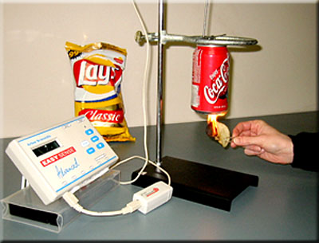
Metabolic Diseases Lesson 1.5
Part 2: Nutrients and the calorie:
What food’s in your food?

Slide 2
Definition
Macronutrients are: Carbohydrates, Fats/Lipids, and Protein that the body uses for calories and structure.
Micronutrients are: Vitamins and Minerals that the body uses to help perform important functions.

Slide 3
Small Group Brainstorm
Answer the question on your worksheet:
What foods are rich in carbohydrates?

Slide 4
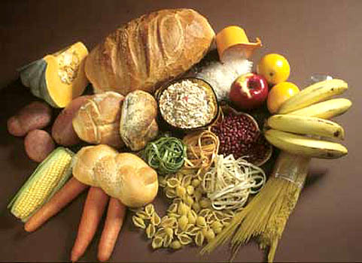
Carbohydrates
Are found in:
Fruits
Vegetables
Dairy products
Cereals
Bread
Pasta
Desserts

Slide 5
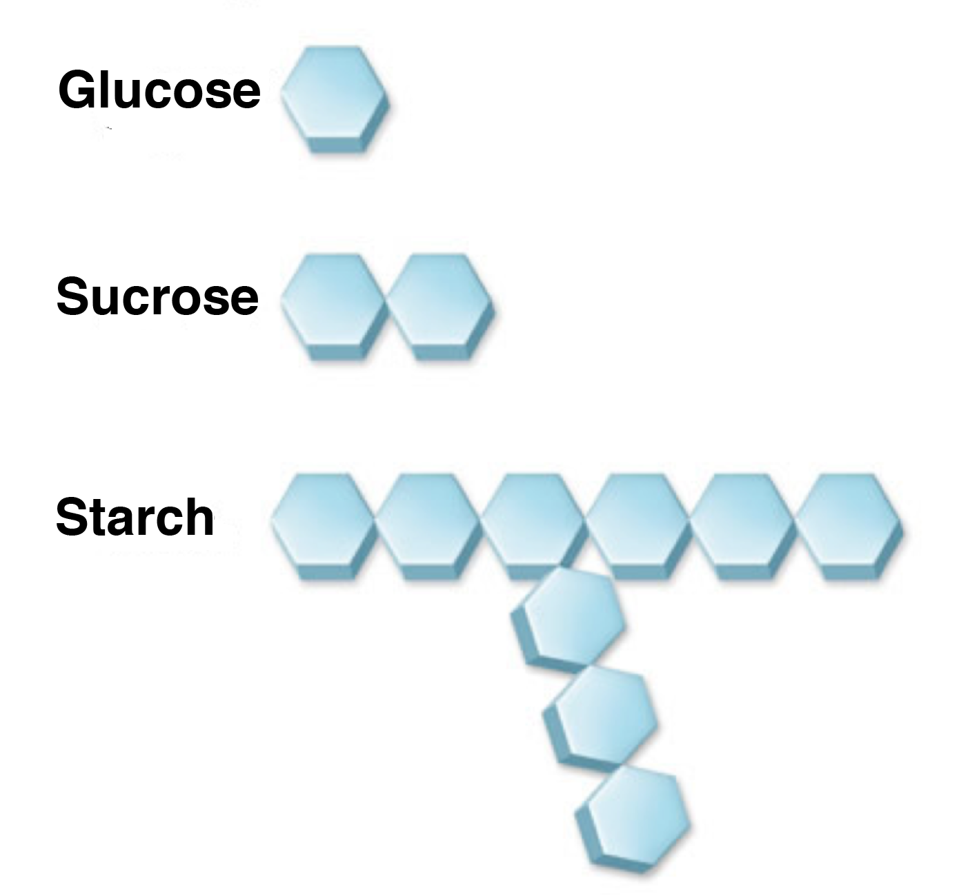
Carbohydrates are built from sugars (monosaccharides)
Monosaccharide
Disaccharide
Complex saccharide

Slide 6
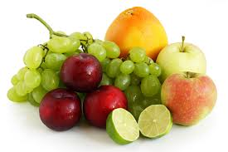
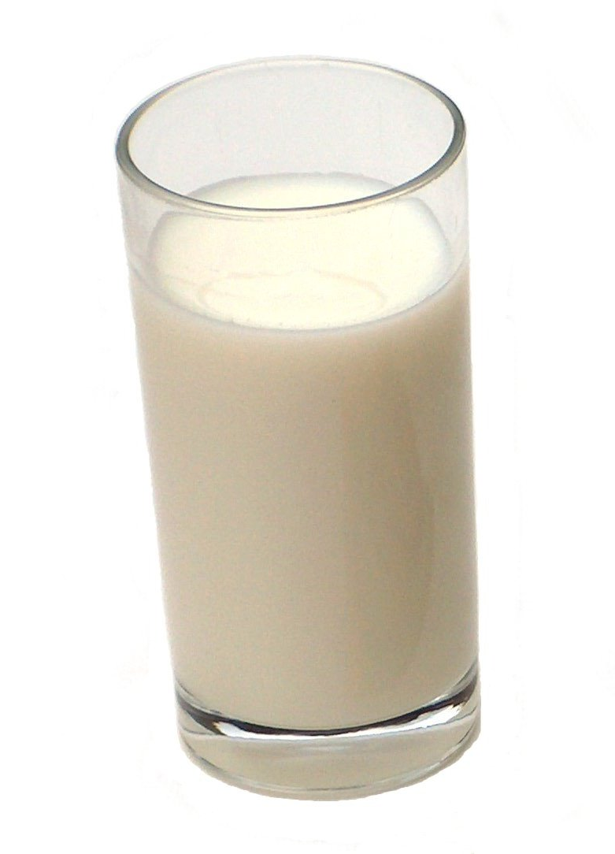
Simple carbohydrates Mono- and Disaccharides:
Are found in sodas, desserts, dairy and fruit
What are the mono- and disaccharides in each of the foods above?

Slide 7
Simple carbohydrates: Mono- and Disaccharides
Glucose
Fructose
Galactose
Monosaccharides
Disaccharides
Sucrose
Lactose

Slide 8
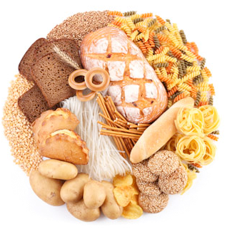
Complex carbohydrates Starches and fiber:
Are found in plants - vegetables and grains

Slide 9
Complex carbohydrates: Starch and Fiber
Starch
(ex: amylose)
Fiber
(ex: cellulose)
Digestible
Not digestible

Slide 10
All carbohydrates must be broken down to monosaccharides to be absorbed from the intestine

Slide 11
How monosaccharides are linked together determines whether a carbohydrate can be digested
Not digestible
Digestible

Slide 12
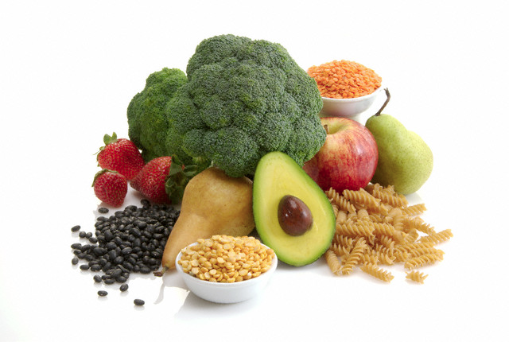
What about Fiber?
Fiber is found in plants and grains.
The types of bonds linking the sugars together make fiber indigestible

Slide 13
Small Group Brainstorm
Answer the question on your worksheet:
Why are simple sugars absorbed into the blood quicker than complex carbohydrates?

Slide 14
Small Group Brainstorm
Answer the question on your worksheet:
What foods are rich in lipids?

Slide 15
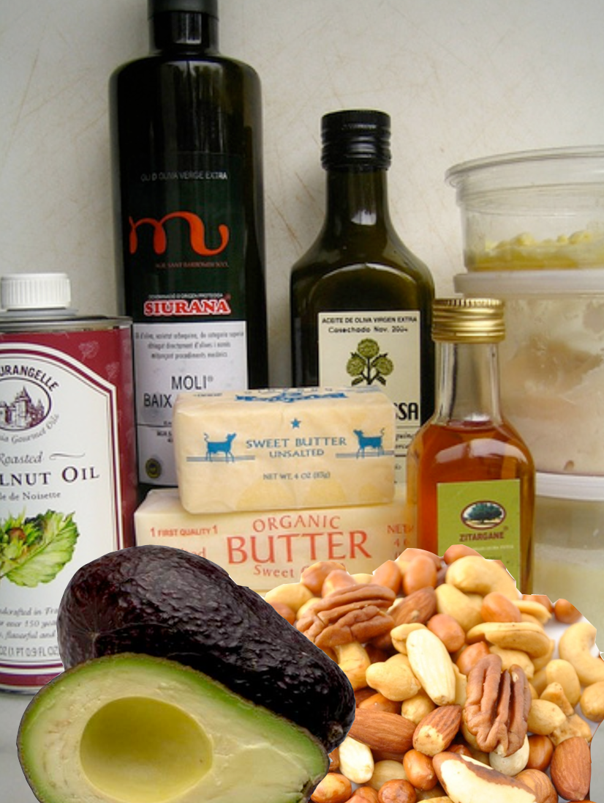
Fats (Lipids)
Are found in:
Vegetable oils
Butter
Margarine
Avocado
Nuts.

Slide 16
Lipids are built from triglycerides
Triglyceride
Glycerol
Fatty Acid 1
Fatty Acid 2
Fatty Acid 3

Slide 17
The length of the fatty acid determines digestion time
Glycerol
Fatty Acid 1
short
Short chain fatty acids
come from butter and whole milk
Medium chain fatty acids
come from coconut and palm oil
Long chain fatty acids
come from meat and plant oils
Fatty Acid 2
Fatty Acid 3
Glycerol
Fatty Acid 1
long
Fatty Acid 2
Fatty Acid 3
How long to digest

Slide 18
Fatty acids can be saturated or unsaturated
Saturated fatty acids are solid at room temperature – ex: butter, coconut oil
Unsaturated fatty acids can be
solid or liquid – ex: vegetable oils or shortening

Slide 19
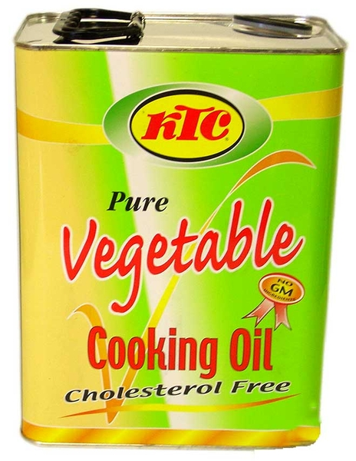
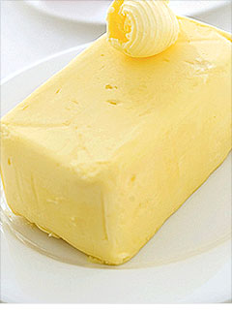
Unsaturated fatty acids can have cis or trans shape
Cis unsaturated fatty acids
are liquid
Trans unsaturated fatty acids
are solid
Trans fatty acids increase the risk of heart disease

Slide 20
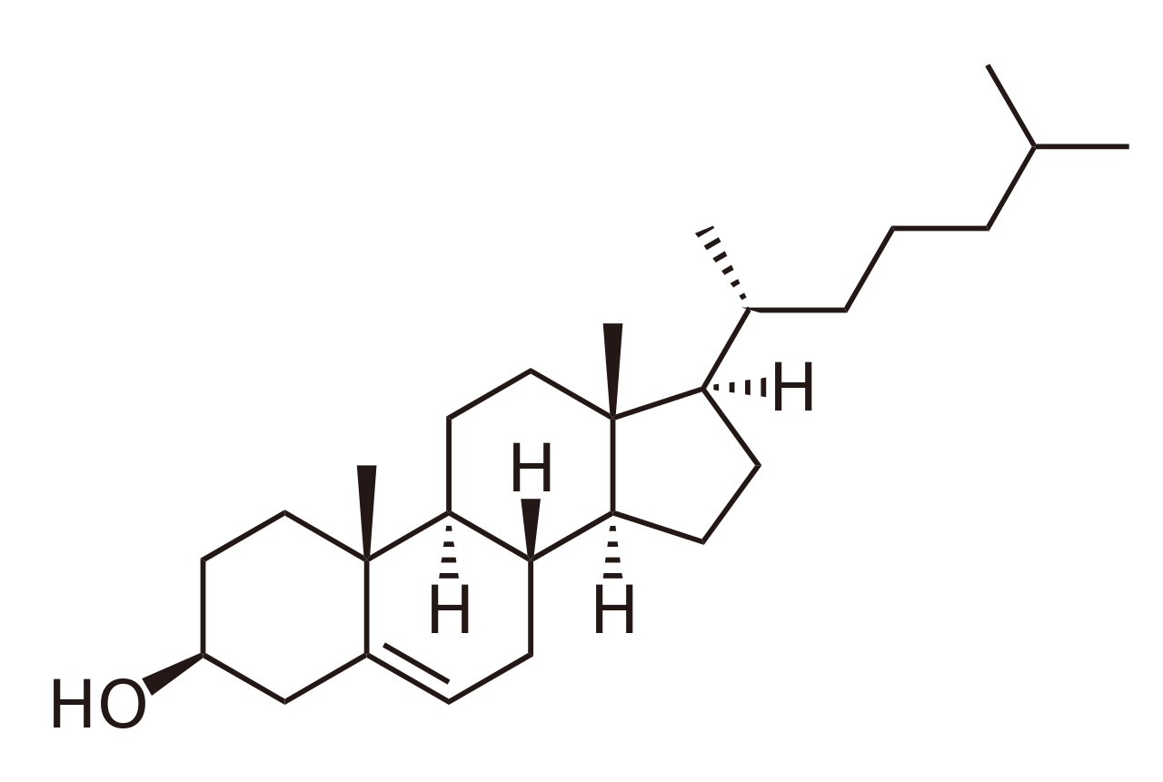
What is cholesterol?
Cholesterol can mean the highly ringed molecule we absorb from animal products….
….or a vesicle that transports lipids in the blood.
Low Density Lipoprotein (LDL)
High Density Lipoprotein (HDL)

Slide 21
Small Group Brainstorm
Answer the question on your worksheet:
Describe the differences and similarities in structure between triglycerides, fatty acids and cholesterol.

Slide 22
Small Group Brainstorm
Answer the question on your worksheet:
Carbohydrates and proteins can float freely in blood. Why do lipids require a special transporter?

Slide 23
Small Group Brainstorm
Answer the question on your worksheet:
What foods are rich in proteins?

Slide 24
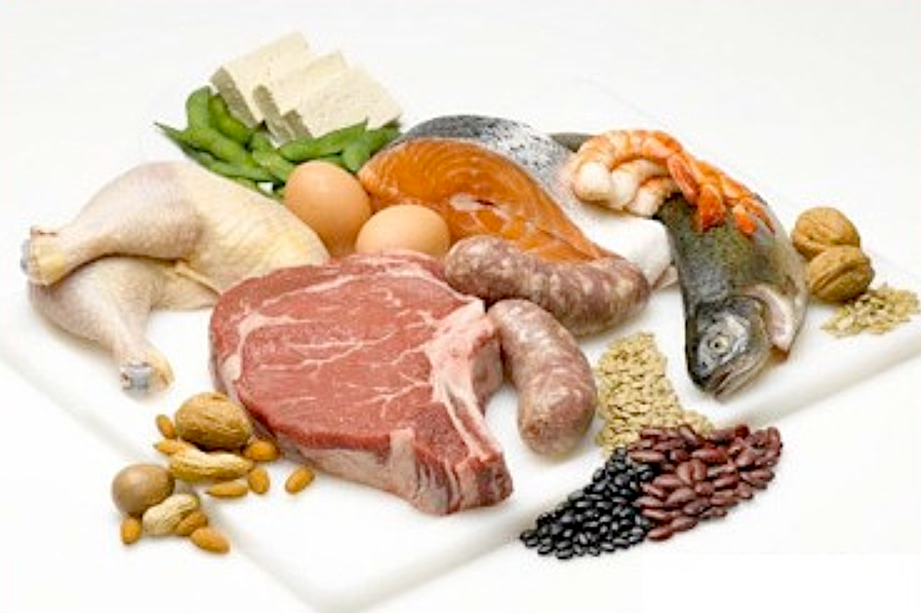
Proteins
Are found in:
Meat
Fish
Dairy
Eggs
Beans
Nuts

Slide 25
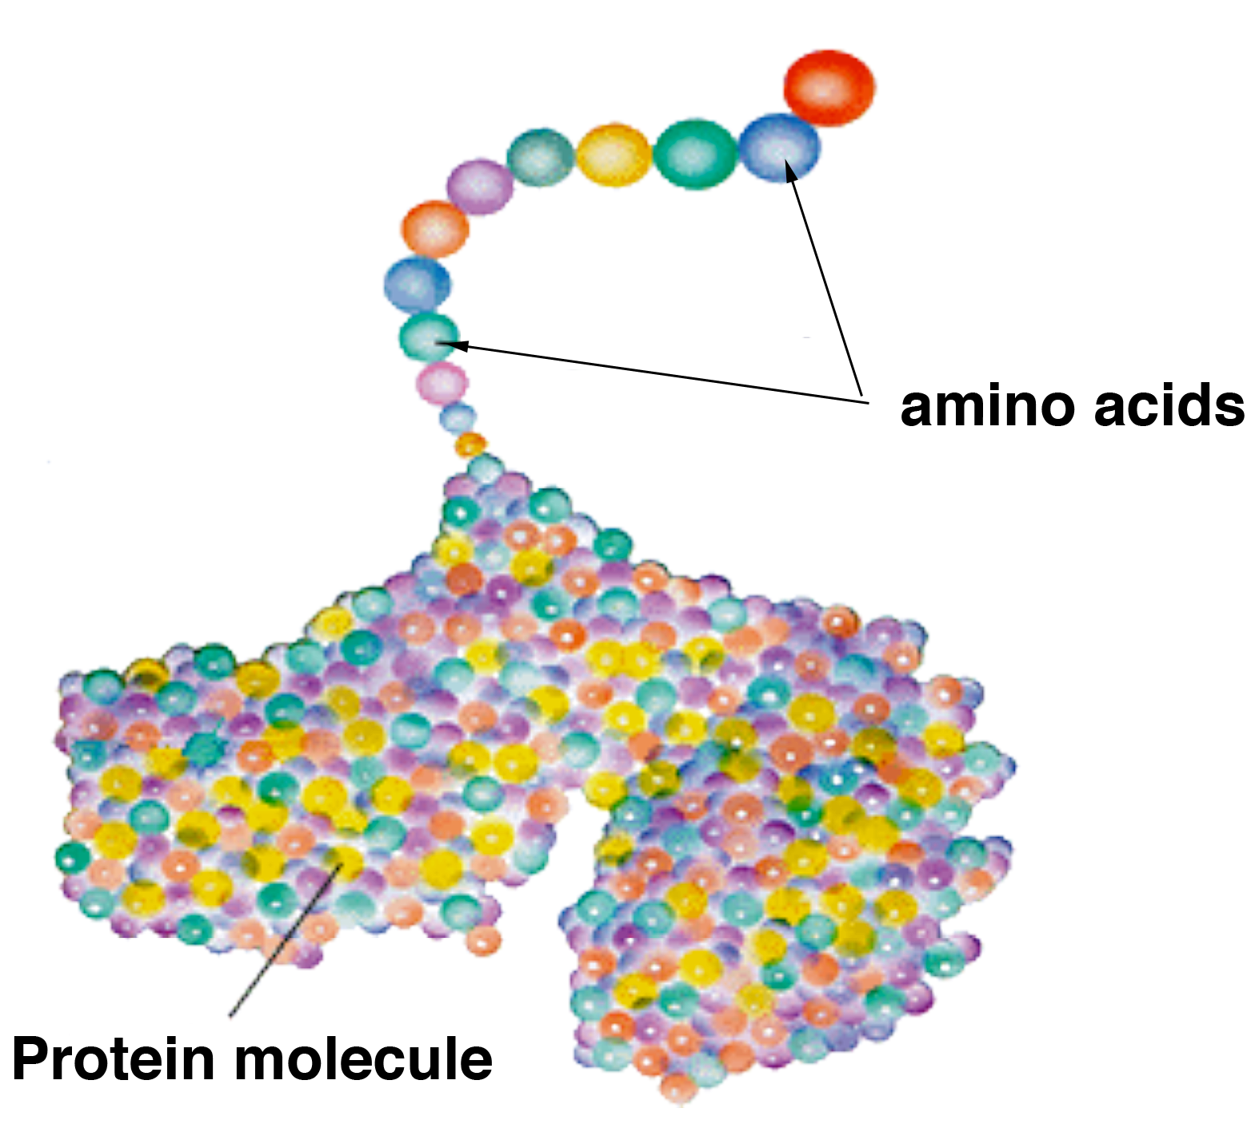
Proteins are chains of amino acids

Slide 26
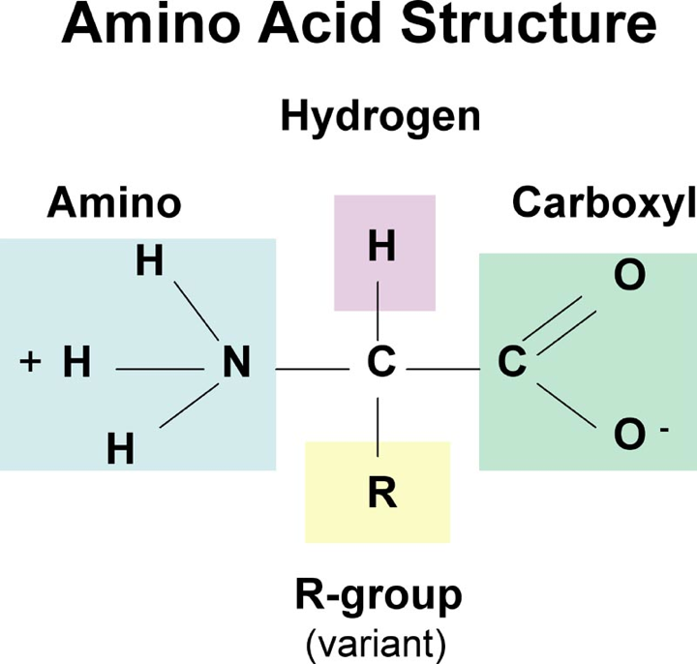
The body uses 20 different kinds of amino acid
Each amino acid has a different ‘R’ group

Slide 27
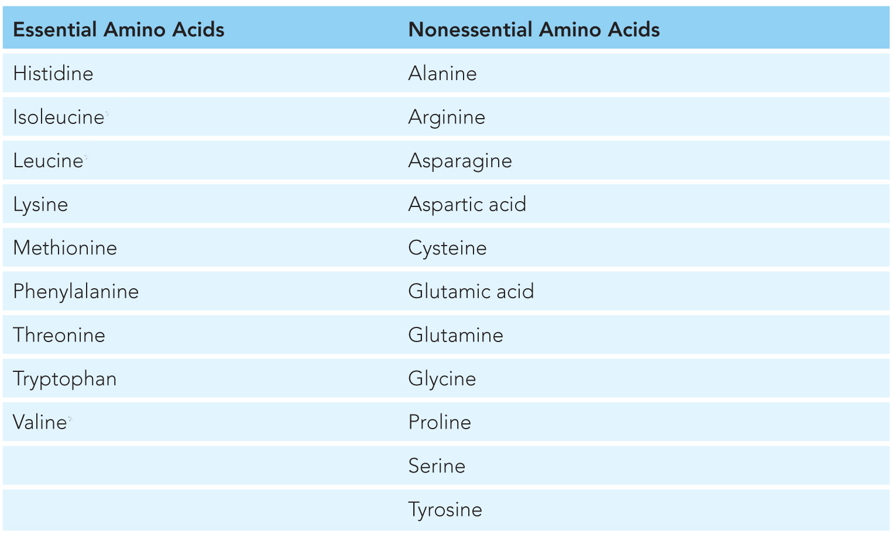
The body can make some amino acids but not all
Essential amino acids must be obtained from the diet

Slide 28
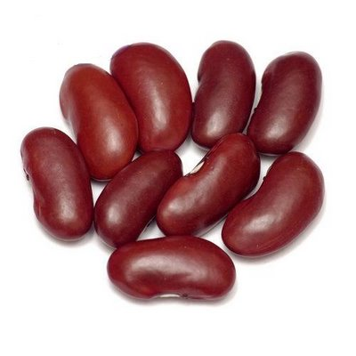
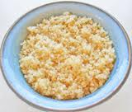
Animal-based proteins are complete – they have all the essential amino acids. Plant-based proteins often aren’t
Only soy and quinoa have complete proteins.
Legumes (beans) have limited methionine and tryptophan
Grains have limited lysine
Vegetarians must make sure they get
all 9 essential amino acids!

Slide 29
Small Group Brainstorm
Answer the question on your worksheet:
How are proteins & amino acids used in the body?

Slide 30
Proteins are used for almost everything!
Build muscle
Make up organs
Hemoglobin to carry oxygen in the blood
Hormones
Antibodies
Cell structure and communication
Enzymes

Slide 31
Small Group Brainstorm
Answer the question on your worksheet:
List as many micronutrients that you can think of. In what foods are these micronutrients found?

Slide 32
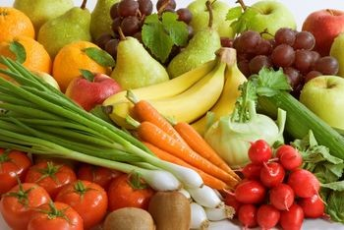
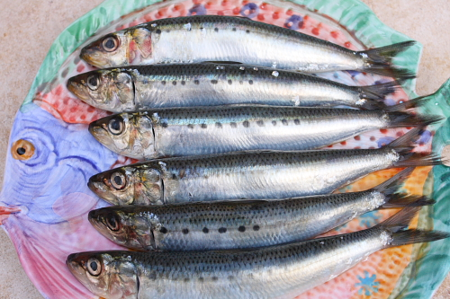
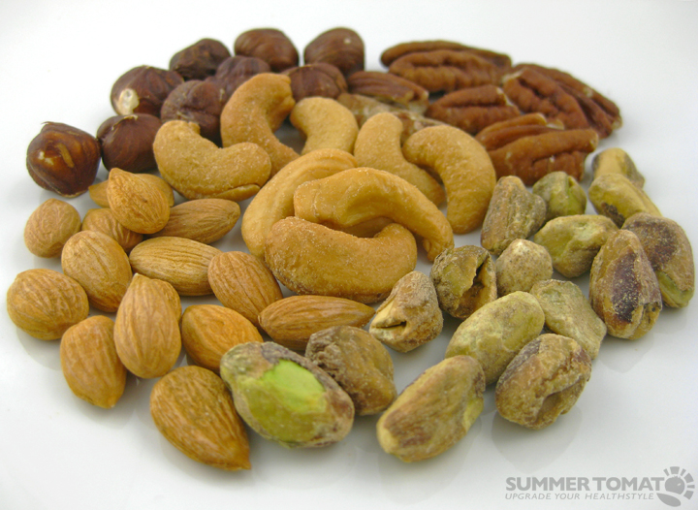
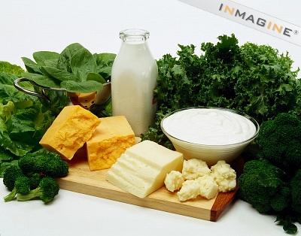
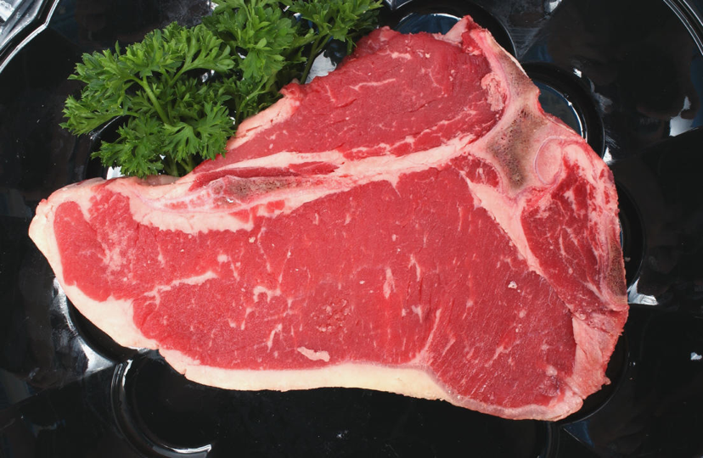
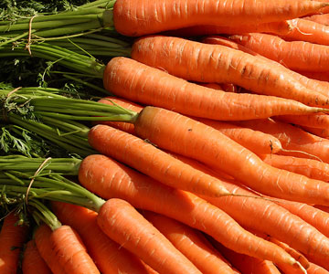
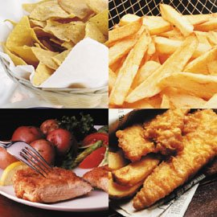
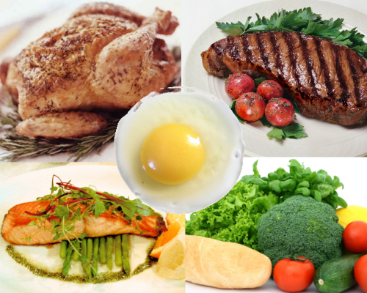
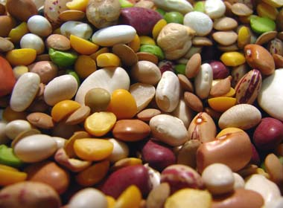
Micronutrients: Critical for health but don’t provide calories Vitamins and Minerals

Slide 33
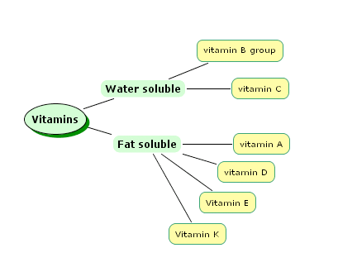
Micronutrients: Vitamins
Easily destroyed by cooking
Easily excreted from body
Must be eaten with fat to be absorbed
Stored in the body for a longer period of time
Can become toxic

Slide 34
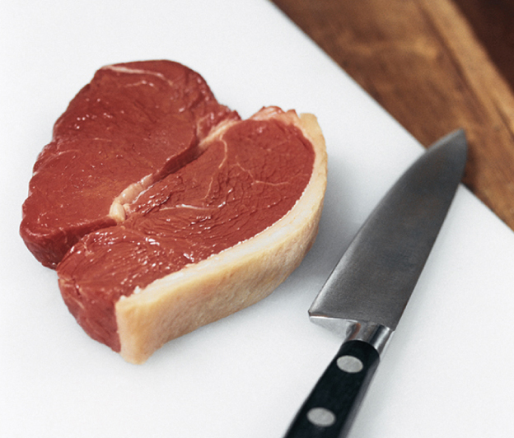
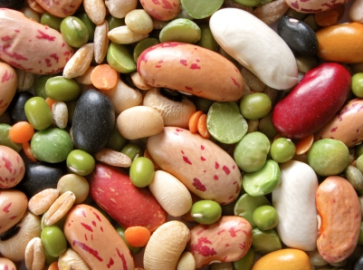
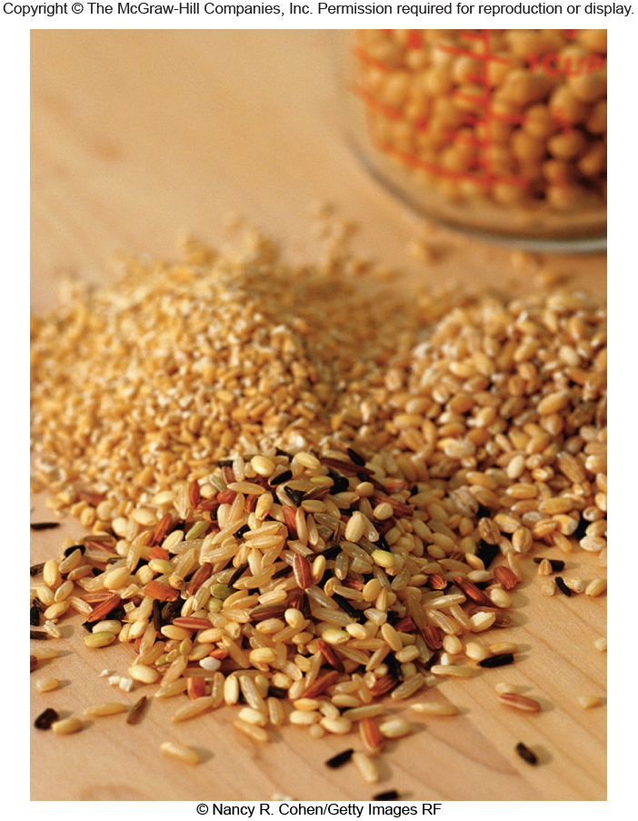
Water soluble - Vitamin B group
Important for the function of enzymes involved in energy metabolism (FAD and NADH are B vitamins).
Found in whole grains, meat, eggs, legumes, dark leafy green vegetables
Deficiency causes many different problems – anemia, dementia

Slide 35
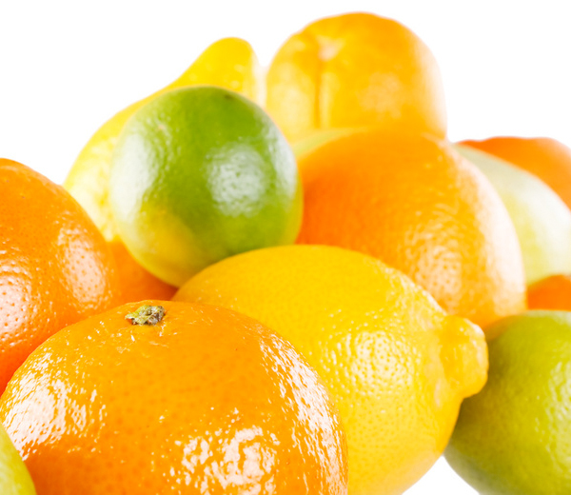
Water soluble - Vitamin C
Is an anti-oxidant and activates many enzymes. It is involved in many cell functions.
Found in citrus, bell peppers, tomatoes, strawberries
Deficiency causes scurvy –
bleeding gums and joint pain

Slide 36
Fat soluble – Vitamin A
Works in vision, immune system, development of the embryo and the skin.
Found in liver, meat, fish. Beta-carotene can be converted to Vitamin A once
absorbed. Beta-carotene is found
in orange foods (carrots,
pumpkin, sweet potatoes)
Deficiency leads to night blindness,
infections, acne.

Slide 37
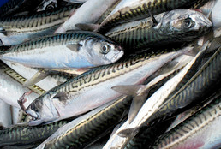
Fat soluble – Vitamin D
Bone health, immune function
Found in fatty fish like salmon and mackerel, and fortified milk. We can make it from cholesterol when exposed to sunlight.
Deficiency leads to rickets,
an abnormality in bone
growth.

Slide 38
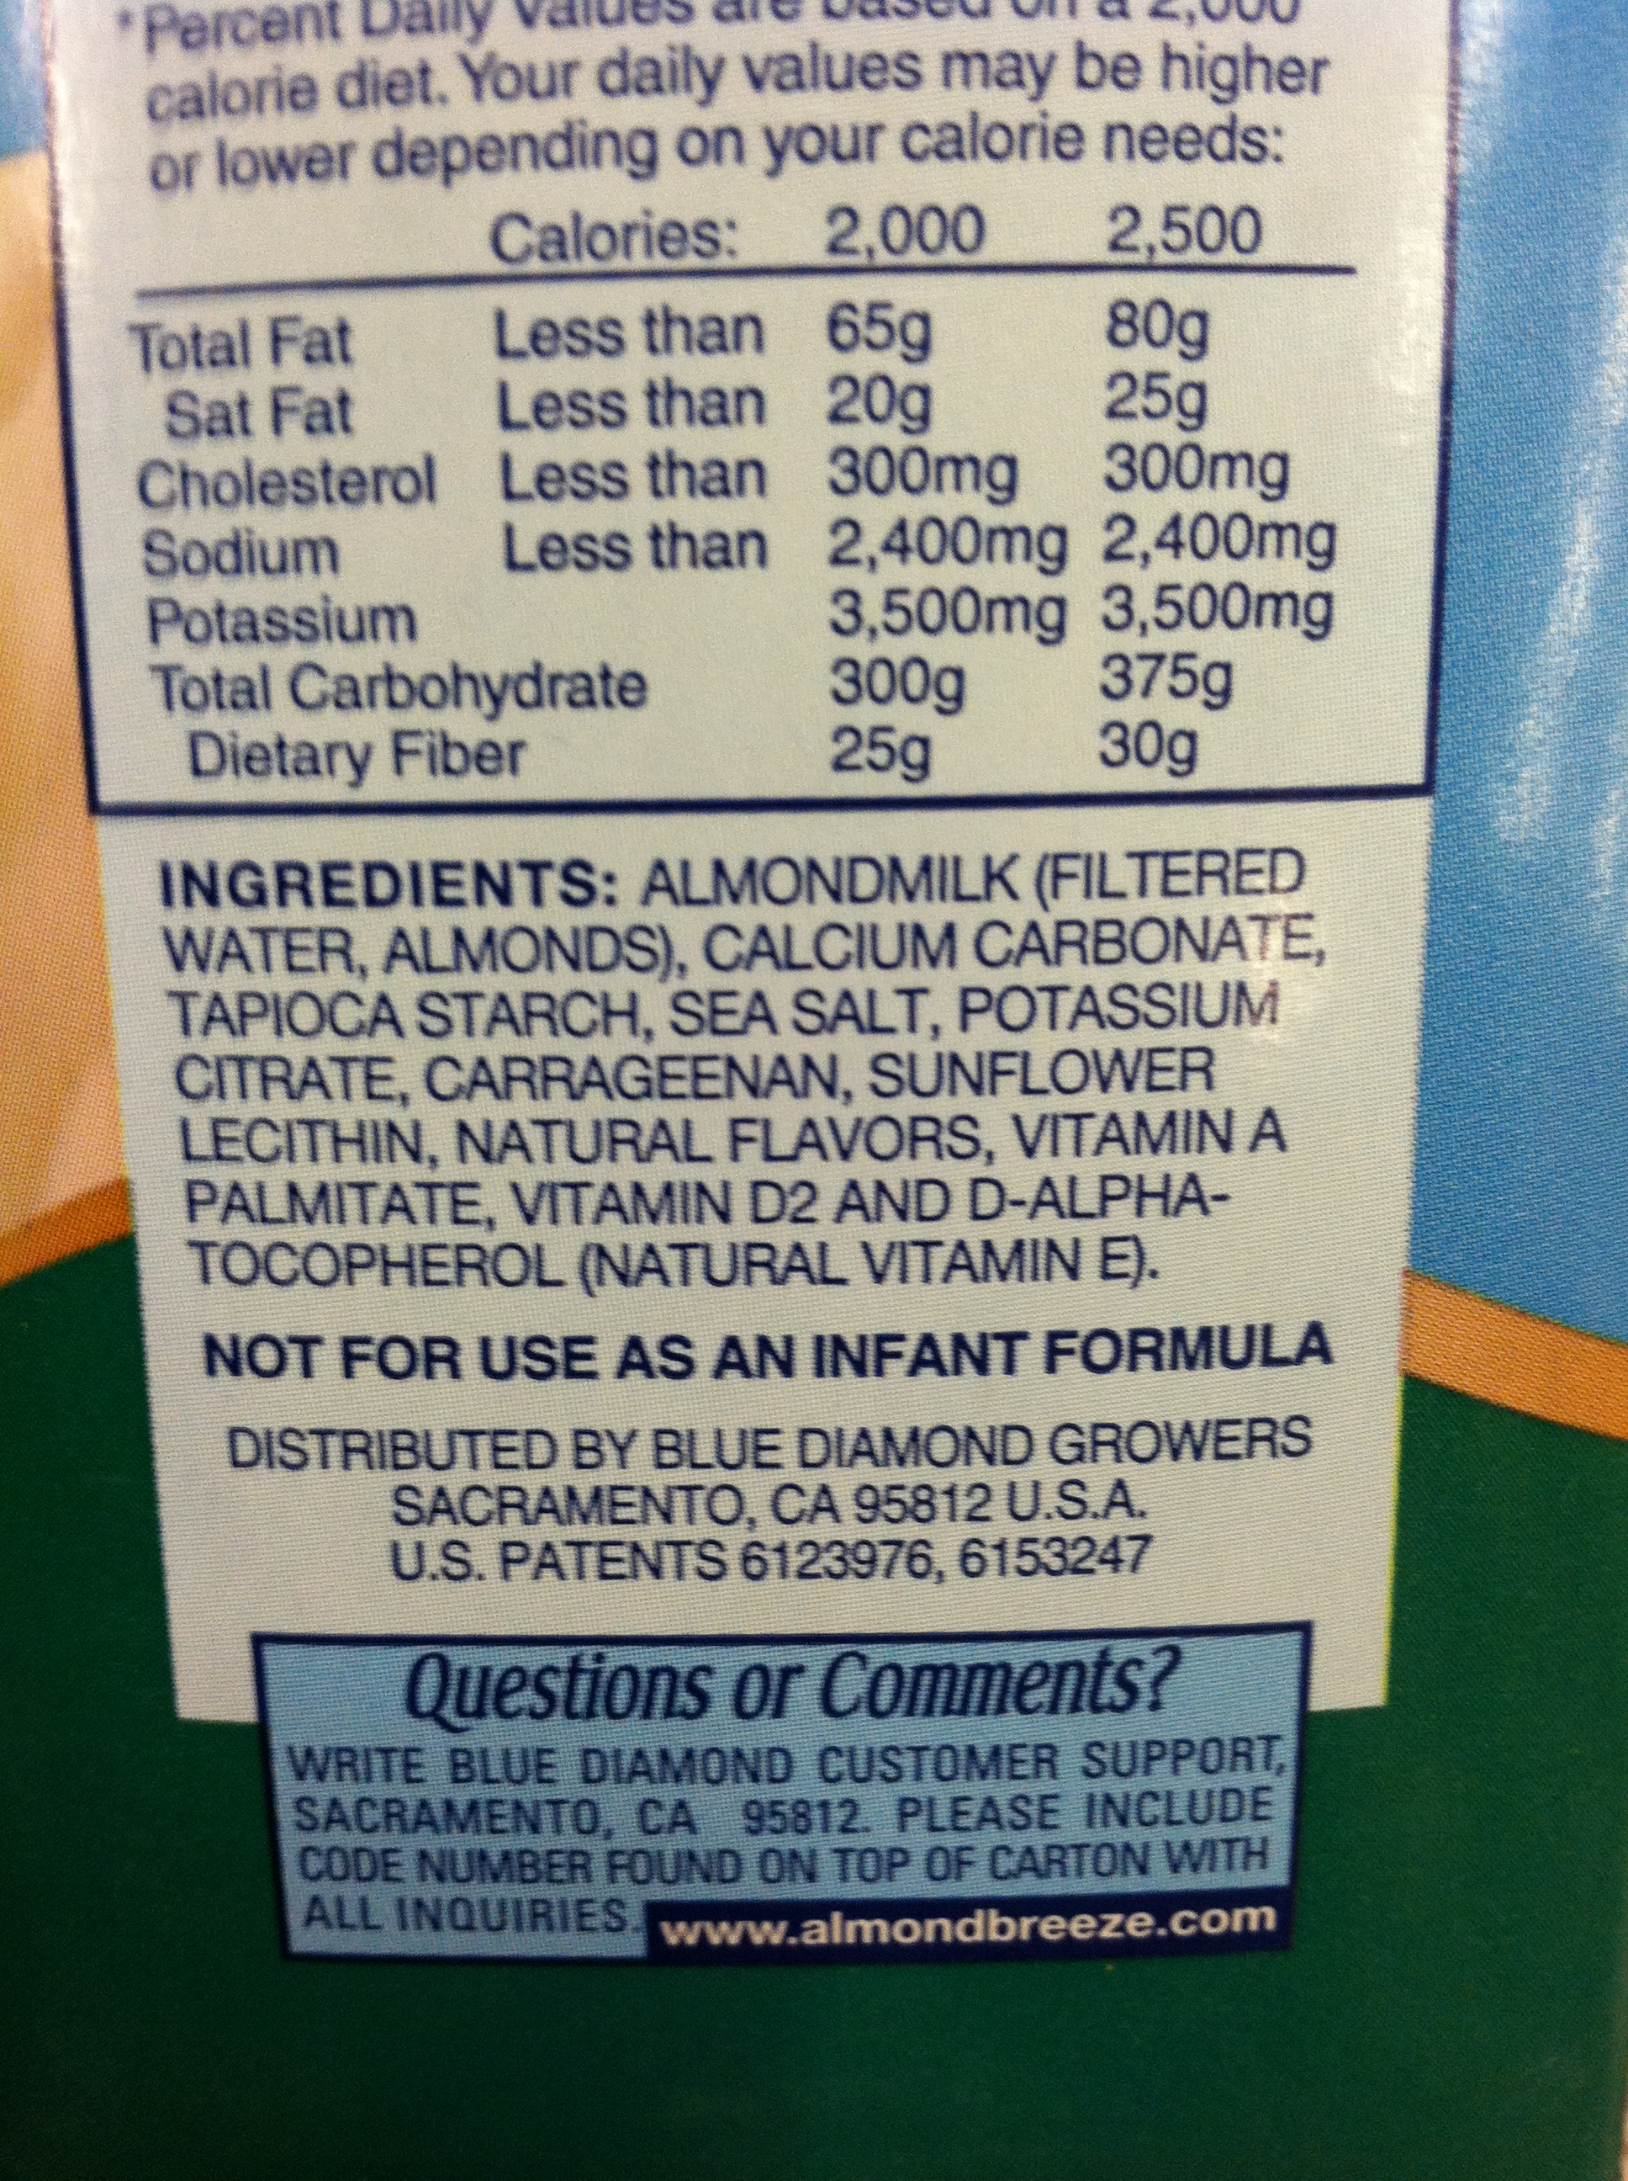
Fat soluble – Vitamin E
Anti-oxidant in cell membranes (because it’s fat soluble)
Found in nuts, seeds and vegetable
oils. Used as a preservative in some
foods (listed as alpha-tocopherol in
ingredients)
Deficiency rare unless there is a
fat-absorption problem.

Slide 39
Small Group Brainstorm
Answer the question on your worksheet:
What do the water soluble vitamins have in common?
What do the fat soluble vitamins have in common?

Slide 40
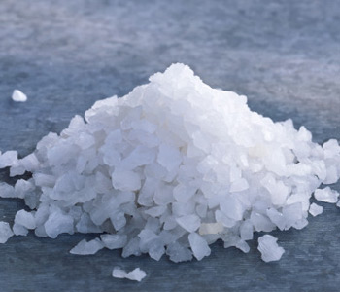
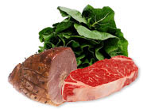
Micronutrients: Minerals
Calcium - Bone health, muscle contraction, nerve function
Potassium - Muscle contraction, nerve function
Sodium - Blood pressure and nerve function
Iron – Carrying oxygen from the lungs to the tissues in the blood

Slide 41
Wrap Up
What structural pattern did you notice with carbohydrates, proteins, and fats?
What micronutrients were familiar and why?

Slide 42
Homework
Finish today’s in-class worksheet and complete the pre-Lesson 2.1 homework.

